Slide 1

INTRODUCTION TO GITHUB
Awais Naeem

Slide 2
Agenda
What is Github ?
Why is GitHub useful?
Important Concepts for Github Users
Understanding Github workflow
Setting up Github
Github Desktop Demo

Slide 3


What is Git & Github ?
Git is an example of version control
Version control is a system that records changes to a file or set of files and helps us recall specific versions later if needed. E.g. Subversion (SVN), CVS etc
It allows you to :
Revert files or the whole project to an earlier state
Compare changes over time
See who modified what?
Control modifications by collaborators with the permission of admin/owners
Github is a a repository hosting service for Git
While Git is a command line tool, GitHub provides a web-based graphical interface that works on top of GIT. It can also be treated as a social platform to share knowledge and work.
It also provides access control and several collaboration features, such as wikis and basic task management tools

Slide 4
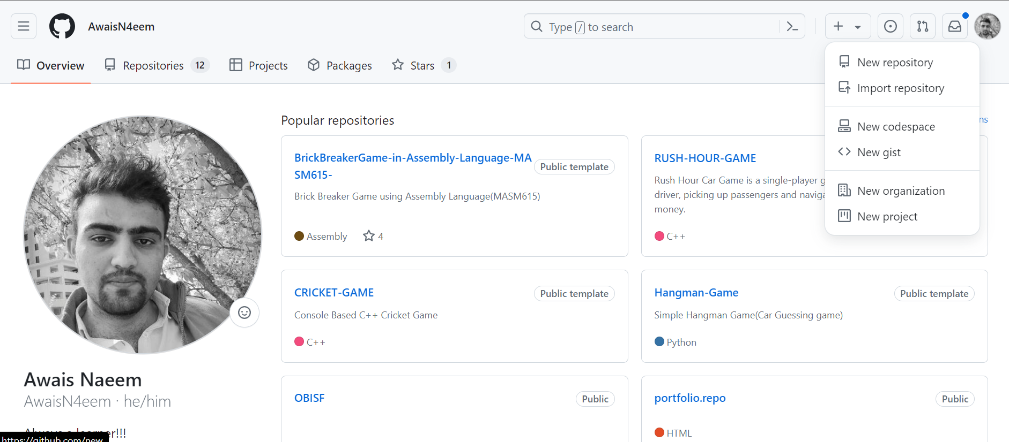

Important Concepts for Github Users
Creating a repo
Creating a repository for multiple people to work together
https://github.com/AwaisN4eem

Slide 5
Important Concepts for Github Users
Creating a Branch
What is a Branch?
A branch in GitHub is like a separate workspace or version of your project where you can make changes and experiment without affecting the main project.
Real-World Analogy:
Imagine you're writing a book with multiple chapters. The main branch (often called main or master) is the published version of your book. Creating a branch is like making a photocopy of a chapter so you can edit or add new content without changing the original chapter.
Why Use Branches?
Isolate Work: Branches allow you to work on new features, fix bugs, or experiment with ideas separately from the main project.
Collaboration: Team members can work on different branches simultaneously without interfering with each other's work.
Safety: Changes made in a branch don't affect the main project until they're reviewed and approved.:

Slide 6
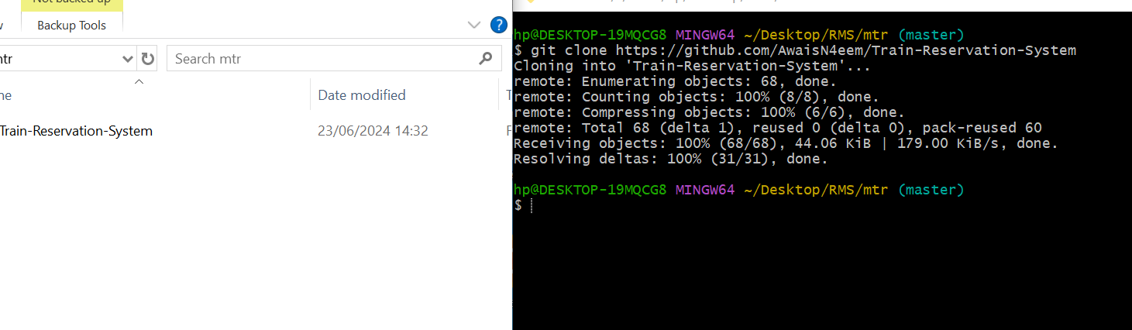
Important Concepts for Github Users
Cloning a Repository:
STEP-1:Navigate to the Repository Page
STEP-2:Copy the Repository URL
STEP-3:Copy the Repository URL

Slide 7

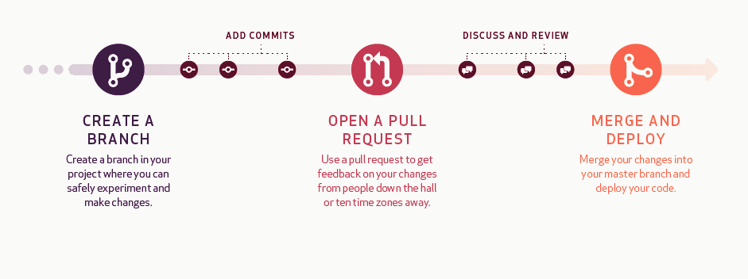
Understanding Github Workflow
*Deploying the code is for development projects
Commit
Comment on Pull request
Close Pull request
Compare
Sync or Push to branch
Add Issues/ Resolve Issues Mention Individuals
Git flow: https://guides.github.com/introduction/flow/

Slide 8
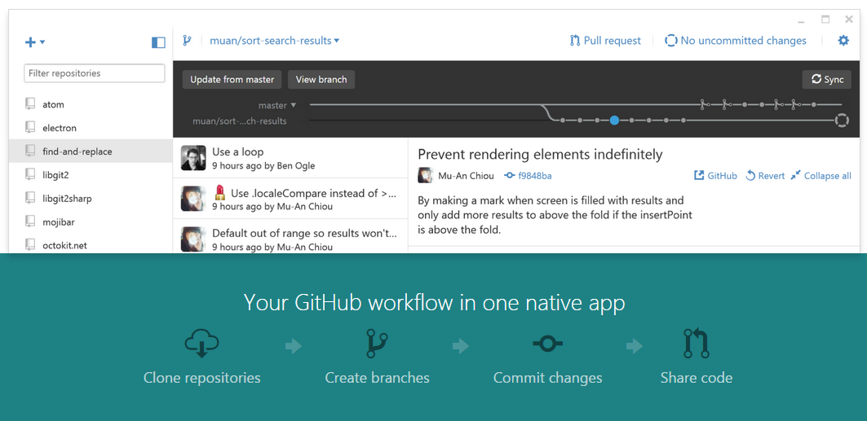
Github Desktop Demo
Link to download Github Desktop : https://desktop.github.com/

Slide 9
Conclusion
Awais Naeem

